Slide 1
Power Of Measurement To Attain True Agility
Meetu Arora
Sr. V.P. Quality Assurance
Info Edge India Ltd (Naukri.com)

Slide 2
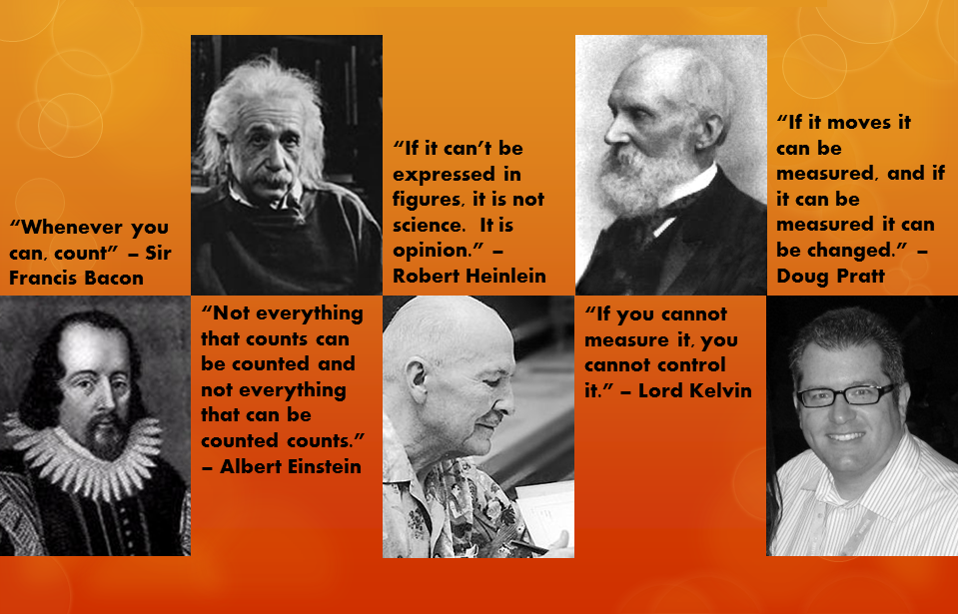
Image Source: http://www.personalchange.info/2012/01/quotes-on-measurement.html

Slide 3

Image Source: http://quoteaddicts.com/topic/measurement-quotes/

Slide 4
MISSION
Create “Delivery Machine” for faster execution of projects with Better Quality

Slide 5
Our Chosen Path XPSCRUMBAN
Change all Measurements from
ME to WE

Slide 6
Our Measurement Mantra
Quantity
Quality
Planning

Slide 7
Better Planning for Faster Execution

Slide 8
Better Planning for Faster Execution

Slide 9
Learnings
Too much getting planned BUT Too little is getting done
Predictability is poor due to last minute planning leading to lack of analysis
Inadequate intra team dependency management
Bugs/Issues increasing
Too many unknowns due to last minute planning
Unplanned Stories getting added to running sprint increasing
Inadequate planning and clarity
Stories not going to production
Stories are not actually following INVEST
Story breakage pattern is not supporting go live

Slide 10
Adopted Changes
Product backlog grooming is done one iteration in advance
Tester, developer, product owner, architect are all part of the backlog grooming
Entire scrum team focuses on defining what and how
Stories breakage to follow INVEST
Testers contribute test cases upfront during this period and add them to the user stories in form of acceptance criteria or alternate paths
We measure planning efficiency
This effectively ensures that team pushes back unplanned items and focuses more towards completion of planned stories
This encourages product managers to work towards providing stories in planned fashion ,up ahead in time.

Slide 11
Results
Velocity: 25% increase
30 % Planning Efficiency improvement

Slide 12
Better Quality for Faster Execution
Defect Introduction points
Concept
Coding
Staging
Post Live
Nature of Defects
Functional
Integration
GUI Level
Ways of catching defects
Test Automation
Scheduled Test Execution

Slide 13
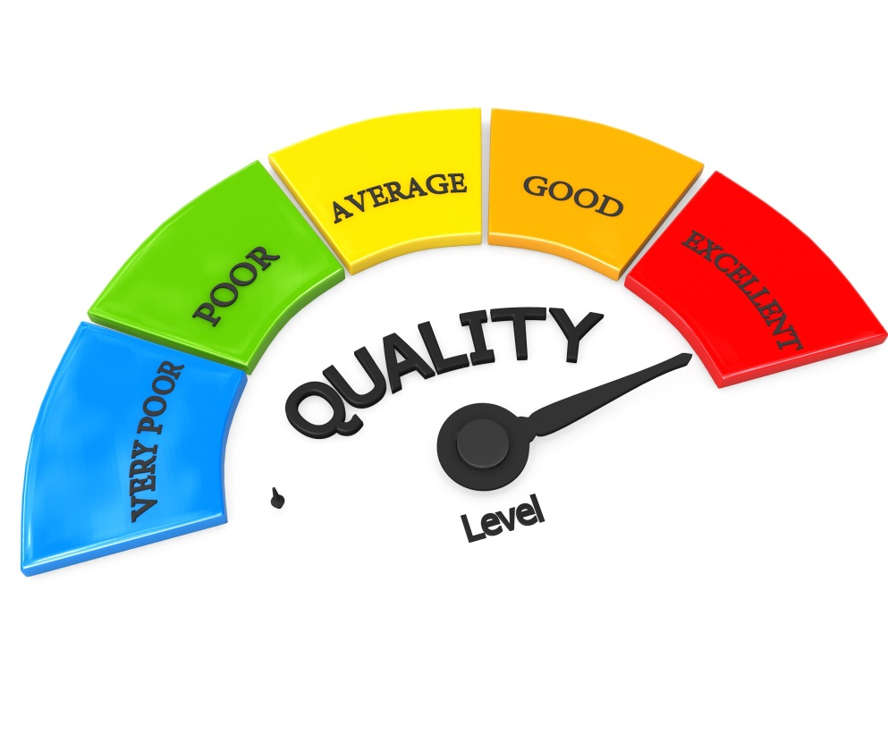
Build Quality Meter
Defect Introduction Points: Product design, Incomplete requirement, Insufficient impact analysis, Dead on Arrival, Inadequate testing, StagingDiscovery, PostLive
Nature of Defects: Functional, GUI, Implicit, Validation, Environment, Configuration, Integration

Slide 14
Build Quality Report

Slide 15
Learnings
Lack of Focus
Lack of RCA
Insufficient impact analysis
Lack of testing at the time of development
Lack of awareness regarding Implicit requirements

Slide 16
Adopted Changes
Backlog grooming to include technical design discussions
Upfront availability of test cases in form of acceptance criteria as part of story
Testing Throughout towards Defect Prevention
Unit level testing
Peer Level Testing
Code reviews
Automatic UT execution using Jenkins
Parallel Functional Automation testing
Automatic FT execution using Jenkins

Slide 17
Better Quality for Faster Execution
Focus on getting adequate Automation Coverage

Slide 18
Better Quality for Faster Execution
Focus on ensuring Automated Tests Execution
Jenkins Usage for automated execution of UT & FT
Daily automated report is published back to the team
UT/FT Suites Daily Execution Summary
 | 01-May-16 | 02-May-16 | 03-May-16 | 04-May-16 | 05-May-16
Jenkins Job 1 | 100% | 95% | 99% | 100% | 100%
Jenkins Job 2 | 98% | Build Aborted | 97% | 80% | 98%
Jenkins Job 3 | 100% | 98% | 100% | 99% | 98%
Jenkins Job 4 | 99% | 97% | Build Aborted | 99% | 93%
Jenkins Job 5 | 93% | 98% | 98% | 100% | 99%

Slide 19
Better Quality for Faster Execution
Focus on ensuring Automated Tests Execution
Automation Tests Execution Time Measurement - Jenkins
Execution time of FT suites brought down significantly by using Selenium Grid

Slide 20
Better Quality for Faster Execution
Focus on Automated Bug Logging
TestLink JIRA Integration Done
Automation Framework integration with JIRA Done
Failures from live executions logged automatically into JIRA

Slide 21
Better Quality for Faster Execution
Focus on Bug Causal Analysis from Coverage Perspective
Bugs reviewed to analysis whether UT and FT was done or not
If done what was the cause of bug slippage
Inadequate coverage
Execution
Rosters for BCA and Automated Test Failure Analysis

Slide 22

Results
15% Build quality improvement
Post live defect seepage: 50% reduction
Test Cases: 10K increase
Automation Coverage: 44% increase
Automation Scripts Execution time: 20% reduction
Automation flakiness: 20% reduction

Slide 23
Key Take Away’s
Defining the “Right Metric”
Measure, Review, Improve ….
Multiple Metrics to cover multiple angles
Qualitative Reviews to prevent data corruption

Slide 24


Slide 25

Meetu Arora
Sr. VP Quality Assurance
meetu.arora@naukri.com

